Slide 1
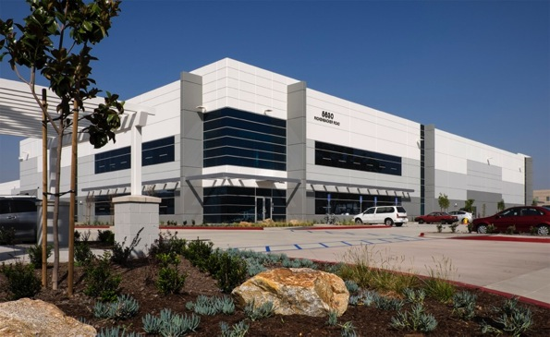
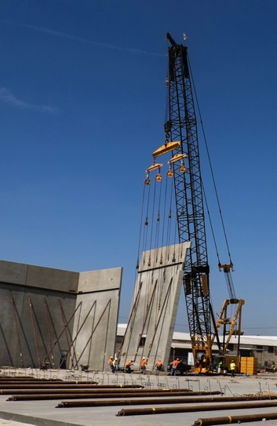
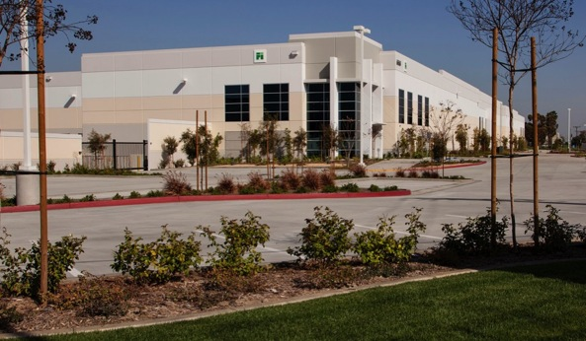
A City Reborn

Slide 2
Challenges
 | Bell | Statewide
Persons Below Poverty Level | 22.6% | 13.7%
Median Household Income | $38,473 | $60,883
Per Capita Income | $12,671 | $28,188
Home Ownership | 27.8% | 57.4%
Unemployment Rate | 10.4% | 7.3%
High School Graduates | 42.3% | 80.7%
Bachelor's Degree or Higher | 3.8% | 30.1%

Slide 3
Challenges – 6/2012
Sales tax - $1.5 million annually
Biggest sales tax generators are gas stations
Over 90% sales tax leakage
Surrounding cities attracted major retailers
High tax burden on residents, 2nd highest in LA County, 10% UUT

Slide 4
Challenges – 6/2012
$150M in debt
$200K in general fund reserves
55 lawsuits
3 annual audits pass due
Up to 30 months of financial transactions not posted
Low morale

Slide 5
Rizzo’s Unpunished Crime
Left City in economic decay
Squandered “Redevelopment Agency” funding
Extorted businesses
Squandered bond money – borrowed $35M for sports complex that was never built
After refunding, still $18.6M left to pay

Slide 6
State Controller’s 2010 Findings
Hire outside firm to develop policies & procedures
Create procedures on how to disseminate internal information
Create risk assessment systems for city operations
Establish mechanisms to anticipate, identify, and react to events affecting achievement of objectives

Slide 7
The Strategy
Commit to the legal fight for the long haul & find a way to fund it
Complete 3 years of past due audits
Bring daily transactions current
Dexia

Slide 8
Dexia Default
Rizzo left behind a disastrous land deal
Owed $38M on 23.4 acres of industrial property valued at $21M
Facing deficiency judgment of up to $15M if not resolved
Bankruptcy for sure if not resolved

Slide 9
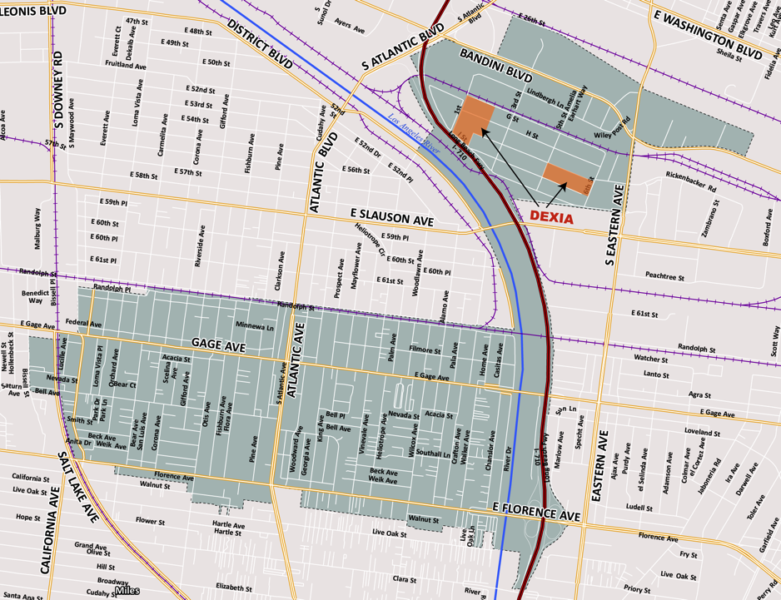
710 Freeway

Slide 10
Dexia Resolution
Plan – entitle property to raise value & lower risk to buyer
Entitled in only 5 months
Sold to Pacific Industrial for $29M
Less than a year later - New 23 acre, 500,000 SF industrial development with Fedex as anchor

Slide 11
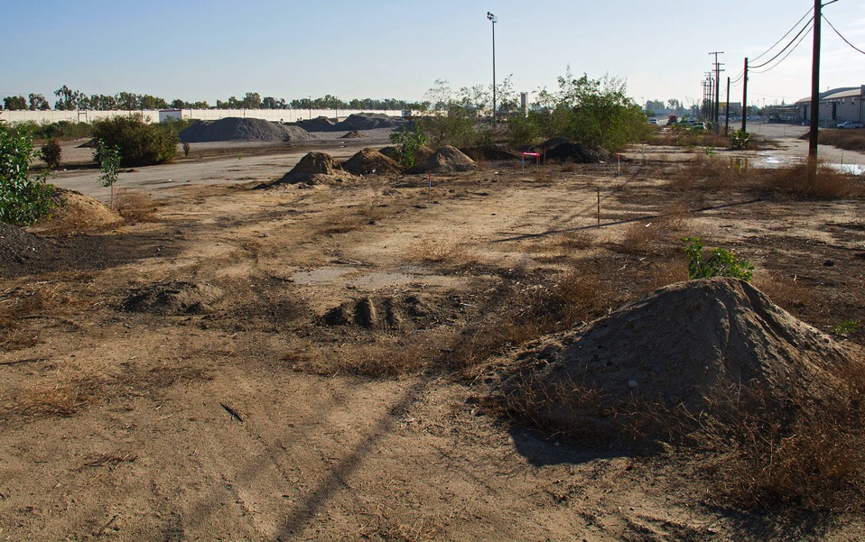

Slide 12
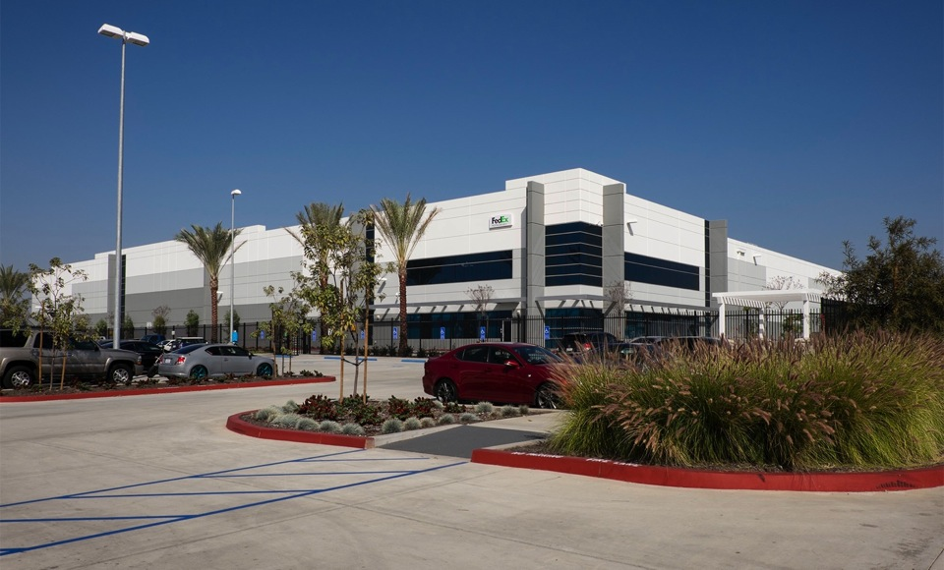

Slide 13
“Auditors faulted city for not following more than 20 recommendations from controller’s office”
LA Times, May 22, 2013

Slide 14
Total City & Agency Debt
-53%

Slide 15
Legal Recoveries
Recovered $5.7M from firms
Recovered $4.8M from Rizzo’s fraudulent retirement scheme
More than $500,000 in restitution from individuals
55 lawsuits when I started; now, down to just a handful

Slide 16
General Fund Reserves
– $1.5M

Slide 17
Bell: 2015
Financial recovery achieved
Completed 5 annual audits within 25 months
Established new financial controls & practices
Governance on solid foundation
Blueprint in place to revitalize Bell

Slide 18
A Hopeful Future
Serious challenges remain
CALPERS rates will increase
Tax burden
Structural imbalance
Economic development
A better future is only possible with growth in commercial tax base

